Slide 1
"Relaxation, Simplified, and Delivered!!"

Slide 2
Who is Pamper Us Mobile?
CHARLOTTE'S 1ST MOBILE SPA COMPANY
What do we offer?
100% MOBILE CORPORATE AND RESIDENTIAL
Massage Therapy Services (Table & Chair)
Nail Services
Make Up Services
Private Chef Services
DELIVERED TO YOUR HOME, HOTEL, OR BUSINESS WITHIN 24 HOURS

Slide 3
The Dream Team
BRANDI FOX
Founder
YVONNE YOUNG
Mobile Spa Concierge
DEMETRIA LINDSAY
Accountant
ZANIA SCOTT
Social Media Specialist
PATRICE FRILOT
Social Media Specialist
JANIA MASSEY
Business Advisor

Slide 4
Why opt for mobile spa services?
PEOPLE WANT FAST, CONVENIENT SELF-CARE OPTIONS ON THEIR TIME, WITHIN THE COMFORT OF THEIR HOME OR LOCATION OF CHOICE.

Slide 5
The Problem
Increase in personal and workplace stress
Limited time for self care services
Unbalance in work and home life
Decrease in quality time with friends and loved ones

Slide 6
THE SOLUTION
PAMPER US MOBILE MASSAGE SERVICE
THE PAMPER LOUNGE,
NC'S 1ST SPA ON WHEELS
CONVENIENT
Easy and fast streamlined booking process that delivers an array of mobile spa services directly to our customers within 24 hours
"Bring the Spa to You" by allowing your employees to walk out of the office right onto mobile spa bliss.
WIDE VARIETY OF OPTIONS
VALUE FOR MONEY
We offer multiple spa services that can be offered for individuals, groups, or businesses simultaneously.
Our cost for services are at least 10% less than our competition without sacrificing quality

Slide 7
Dilemma of Key Players
BRICK AND MORTAR SPAS
Don't provide the convenience of mobile services
SOOTHE AND ZEEL
Only offers massage therapy services
INDIVIDUAL SPA SERVICE PROVIDERS
Inability to scale due to limits on the number of services
that can be offered

Slide 8
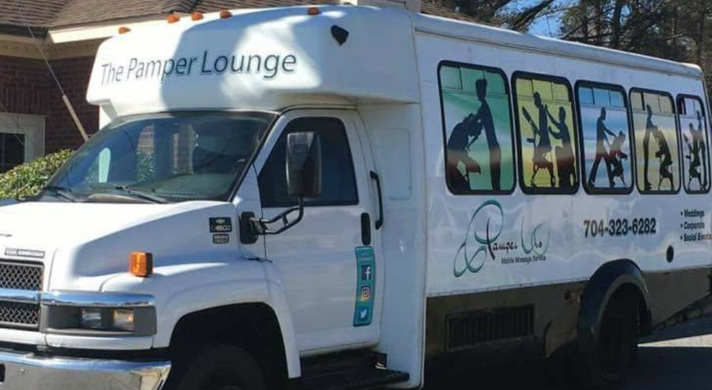
The
Pamper Lounge
Mobile Spa Bliss for Businesses
Chair Massage Therapy
Aromatherapy
Soothing Music
Tranquil Lighting
Handicap Accessible
Accommodates up to 6 guests
NC'S 1ST SPA ON WHEELS

Slide 9
MARKET VALIDATION
Testing Our Idea
KEY FINDINGS

Slide 10
A POSITIVE OUTLOOK
$10B
3/5
42%
U.S. POPULATION THAT
USES ON DEMAND
SERVICES
MILLENIALS INVEST IN
SELF CARE SERVICES
2018 REVENUE FOR THE
SELF-CARE INDUSTRY

Slide 11
BUSINESS MODEL
MARKETING CHANNELS
VALUE PROPOSITION
LinkedIn
Facebook
Instagram
Direct Marketing
Pamper Us Mobile provides self care convenience by "Bringing The Spa to You"
BUYER PERSONAS (B2B)
BUYER PERSONAS (B2C)
Small to large businesses who are looking to increase employee engagement, productivity, and enhance the work environment
Women and Men between the ages of 28-50, middle class to upper middle class income levels, looking for convenient self care options.

Slide 12
MARKET ADOPTION
SUBCONTRACTING
EVENTS
PARTNERSHIPS
Pamper Us Mobile contracts over 40 licensed and certified individuals to perform Pamper Us services
Health and Wellness fairs and events to connect directly with company's and consumers within our target market
Pamper Us Mobile partners with other businesses within the wellness industry to provide services and referrals to their clients

Slide 13
How it Works?
Explore
Book
Relax
Choose one service or
mix and match services
to create your customized
Pamper Us Mobile experience
Book services instantly
or request a customized
service quote.
(cashless/pre-paid billing system)
Relax your mind knowing that
5 Star service is on the way!

Slide 14
HOW WE MAKE MONEY
REVENUE SPLIT
BUSINESSES
Average
40% Contractor
60% Pamper Us
Company paid options
Employee paid options
Recurring service contracts
RESIDENTIAL
SPECIAL SERVICES
Individual services
Group parties
The Relaxation Club (Massage Membership)
Monthly Couples Massage Class
"Wellness in the Workplace" Corporate presentations

Slide 15
$200,000
Our Growth
$150,000
$100,000
2015: $5,500
2016: $20,000
2017: $95,000
2018; $103,000
2019 (Projection): $200,000
$50,000
$0
2015
2016
2017
2018
2019

Slide 16
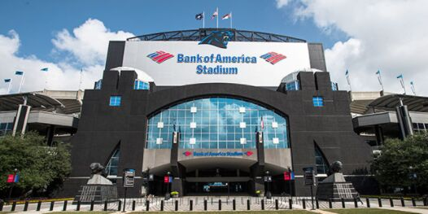
Our Clientele
THOMAS DAVIS FORMER CAROLINA PANTHER
ASHANTI GRAMMY AWARD WINNING R&B ARTIST
CHEF RAMSEY HELL'S KITCHEN
THE MANN'S CHRISTIAN CONTEMPARY ARTIST

Slide 17
WHERE WE ARE GOING
SEPTEMBER 2019
OCTOBER
2019
JANUARY
2020
The Relaxation Club and The Dream Nail Club launches to increase residual income
Pamper Us Loyalty program launches to increase return customers
Pamper Us Mobile launches new website with enhanced booking features

Slide 18
FUNDING NEEDS?
ON-DEMAND APP CREATION
OPERATIONS SOFTWARE CREATION
Increase response time
Geo-Aware software adaption
Fleet optimization
Create web software interface that's compatible to app
Preparation for internal franchising
PAMPER LOUNGE RENOVATIONS
New bus vinyl wrap to enhance visual appeal
Internal updates to enhance onboard spa experience

Slide 19
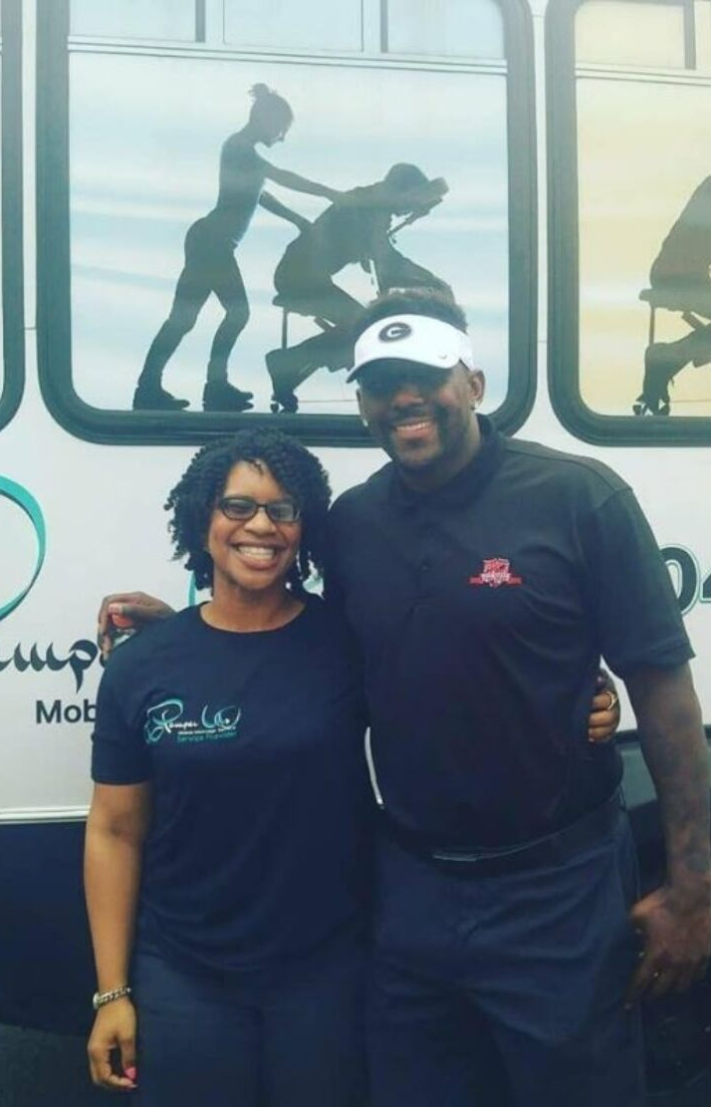
Thomas Davis
(Former Carolina Panther)
Ashanti
(Grammy Award Winning Artist)
WORK WITH US!
EMAIL ADDRESS
brandi.fox@pamperusmms.com
TELEPHONE
704-323-6282 ext. 2
WEBSITE
www.pamperusmms.com

